Slide 1
PROCEDURE
Datasets

Slide 2
ORIGINAL DATASETS
C:\Users\harsh\Downloads\hospital data analysis.csv Hospital data analysis
C:\Users\harsh\Downloads\healthy_meal_plans.csv Meal analysis
C:\Users\harsh\Downloads\diet_recommendations_dataset.csv Diet Recommendation analysis
https://github.com/sohamvsonar/Disease-Prediction-and-Medical-Recommendation-System/tree/main/dataset Disease-Prediction and Medical Recommendation System

Slide 3
Data pre-processing
Healthy Meal Plans (meal_clean.csv)
Original Issues:
Some columns (calories, protein, fat, carbs, prep_time) already normalized (0–1) but inconsistent.
Categorical column meal_name not ML-ready.
Possible duplicates.
Cleaning Steps:
Duplicates Removed – checked and dropped repeats.
Missing Value Imputation – filled any missing numeric values with column mean.
Label Encoding – converted meal_name into numeric labels.
Standardization (Z-score) – standardized nutritional features (calories, protein, fat, carbs, prep_time, num_ingredients) → mean 0, std 1.
Result:
Nutrition features are now comparable.
Meal names encoded for ML models.
Dataset is ready for clustering, classification, or visualization.
C:\Users\harsh\Downloads\meal_clean.csv → Cleaned version

Slide 4
2. Hospital data analysis
Original Issues:
Categorical features (Gender, Condition, Procedure, Readmission, Outcome) not ready for ML.
Potential outliers in Cost.
Numerical features (Age, Cost, Length_of_Stay, Satisfaction) on different scales.
Cleaning Steps:
Duplicates Removed – ensured no repeated patient records.
Categorical Encoding – One-Hot Encoding applied (hospital_encoded.csv).
Normalization (Min-Max) – scaled Age, Cost, Length_of_Stay, Satisfaction → values between 0 and 1.
Outlier Handling (IQR method) – capped extreme Cost values within the upper/lower bounds.
Result:
Two cleaned versions:
hospital_clean.csv → cleaned but original categories intact.
hospital_encoded.csv → fully ML-ready (encoded + normalized).
C:\Users\harsh\Downloads\hospital_clean.csv →hospital cleaned C:\Users\harsh\Downloads\hospital_encoded.csv -> hospital encoded

Slide 5
3. Disease Prediction Dataset
Original Issues (synthetic realistic dataset):
Symptoms were textual.
Categorical fields (Gender, Disease) not ML-ready.
Age on different scale.
Cleaning Steps:
Duplicates Removed – ensured unique patient records.
Label Encoding – converted Gender and Disease into numeric labels.
Normalization (Min-Max) – scaled Age into 0–1 range.
Symptoms Retained as Text (for NLP / one-hot in future pipeline).
Result:
Patient dataset is consistent, age normalized, categorical features encoded.
Can be used for disease prediction models or visualization of symptom trends.
C:\Users\harsh\Downloads\disease_clean.csv -> Disease clean

Slide 6
4. Diet Recommendation Dataset (diet_clean.csv)
Original Issues (synthetic realistic dataset):
Nutrition values (Calories, Protein, Carbs, Fats) on different scales.
Disease names categorical.
Possible duplicates.
Cleaning Steps:
Duplicates Removed – ensured no repeated entries.
Standardization (Z-score) – standardized nutrition columns to make features comparable.
Label Encoding – converted Disease into numeric labels.
Result:
Each disease mapped cleanly to a diet plan + standardized nutrition profile.
Ready for integration with disease prediction output.
C:\Users\harsh\Downloads\diet_clean.csv →Diet clean

Slide 7
So we did the python code Python libraries:
Pandas → for handling missing values, duplicates, merging datasets.
NumPy → for numerical transformations.
Scikit-learn (sklearn) → for normalization, standardization, and encoding.
Sample snippets we implemented 1. Handling Missing Values
df['Calories'].fillna(df['Calories'].mean(), inplace=True)
2. Removing Duplicates
df = df.drop_duplicates()
3.Standardization (Z-score)
from sklearn.preprocessing import StandardScaler
scaler = StandardScaler()
df[['Calories','Protein','Carbs','Fats']] = scaler.fit_transform(df[['Calories','Protein','Carbs','Fats’]])
4. Normalization (Min-Max Scaling)
from sklearn.preprocessing import MinMaxScaler
scaler = MinMaxScaler()
df[['Age','Cost']] = scaler.fit_transform(df[['Age','Cost']])

Slide 8
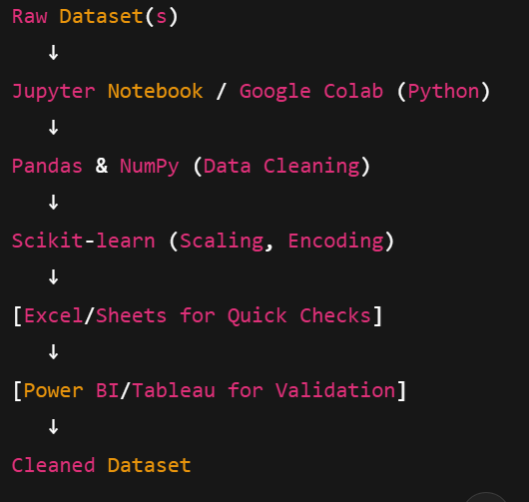
5. Encoding Categorical Columns
from sklearn.preprocessing import OneHotEncoder
encoder = OneHotEncoder()
encoded = encoder.fit_transform(df[['Restrictions']]).toarray()
Python (Pandas, NumPy, scikit-learn) so that the same process can run automatically on any dataset.”
“For example, missing values were imputed with mean, categorical variables were one-hot encoded, and nutrition values were standardized with Standard Scaler
“This makes our system scalable — we can clean hundreds of rows in seconds.”

